Slide 1
Topic: Congruency EQ: How do I know if two shapes are congruent?
Year 8

Slide 2
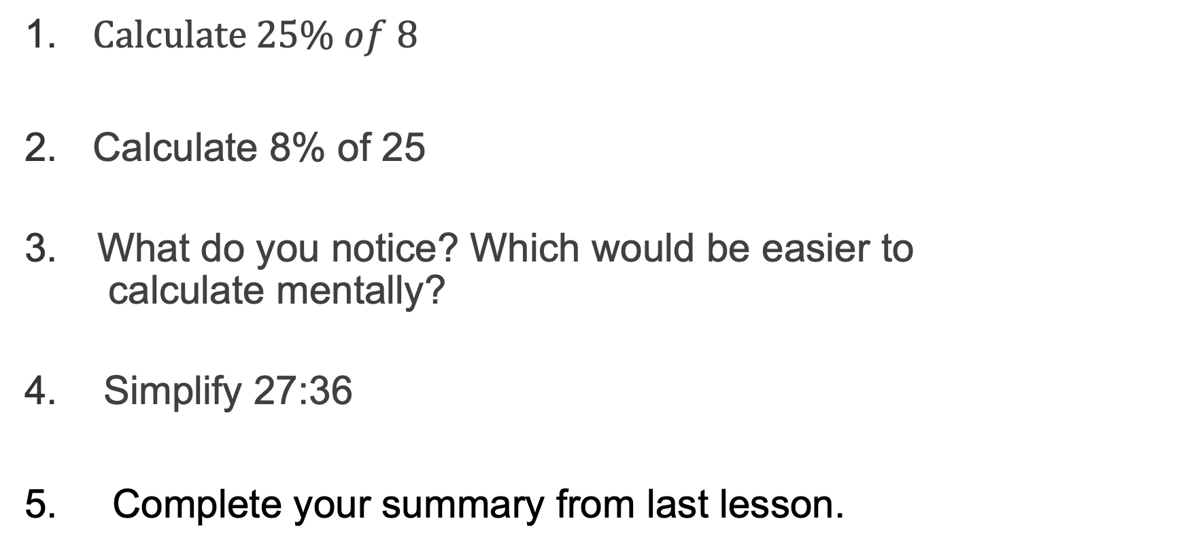
5 Questions
Topic: Congruency
EQ: How do I know if two shapes are congruent?
$Calculate 25\% of 8$
Calculate 8% of 25
What do you notice? Which would be easier to
calculate mentally?
Simplify 27:36
5. Complete your summary from last lesson.

Slide 3
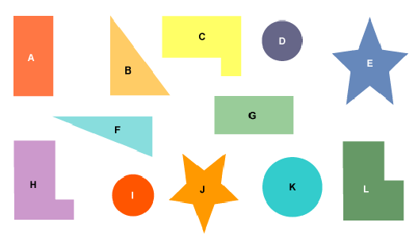
Congruence
Which shapes are the same?
Can you pair them up?

Slide 4
Congruence
A vs A
Notes:
Hold up two pieces of paper with the letter A printed on them. (Print out the congruency doc and cut the first page in half.) Ask if they are the identical.
Move one (translate) and ask again if they are identical
Move one (rotate) and ask again if they are identical
Move on (reflect) and ask again if they are identical
Do a combination of translation, rotation and reflection and ask again if they are identical
Explicitly state that you have translated, rotated and reflected the image and it is identical
Now hold up the single big A with one of the smaller A’s and ask if they are still identical – they are no longer identical. If something has been enlarged, shrunk or stretched it is no longer identical.

Slide 5
24
7
30
Topic: Congruence
Date:
EQ – How do we know if two shapes are congruent?
What are Congruent Shapes?
Congruent shapes have the same shape and size. They can fit exactly on top of each other.
Two figures are congruent if one of them can be transformed to the other using the transformations: reflection, translation and rotation.
If something is enlarged, shrunk or stretched it is no longer congruent.

Slide 6
For example:
✓
✓
✓
✗
✗
✗

Slide 7
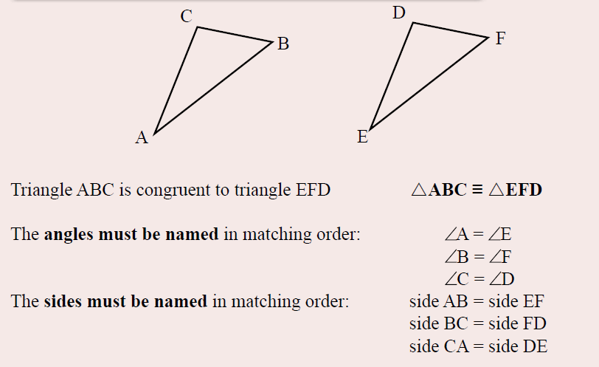

Slide 8
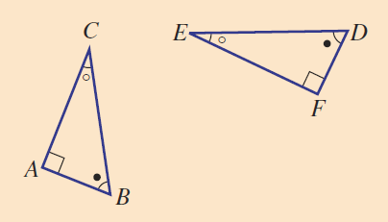
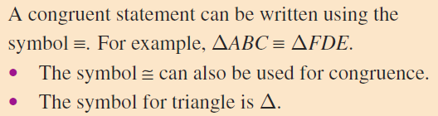

Slide 9

Notes:
Move to Freefall worksheet congruence statements

Slide 10
Task
Complete the worksheet and then glue onto your task page
Notes:
Guide students through the question.
Option 2: Dot plots handout (Scaffolded for kids who may need extra help)

